Slide 1
Welcome to my Presentation E-commerce Website
Submitted By:
Rafi Ahmed
ID:UG02-47-18-030
Batch:47th
Submitted To:
Khan Md .Hasib.
Lecturer ,
State University of Banglades

Slide 2
What is an e-commerce website?
An e-commerce website is a website that allows you to buy and sell of goods, digital products or services online.

Slide 3
Why Ecommerce Website?
We all know that online shopping are becomming populer day by day. Nowadays People love to buy things from online. So old businessman and other new businessman wants to create their personal website for selling products online. So the demand of a e-commerce website is huge.

Slide 4
Aim
Our main aim is to create a user friendly website in which A customer can easily buy products from the shop and user(admin) can easyly see the income/loss per month by individual category.

Slide 5
Advantages
Faster buying process.
Store and product listing creation.
Cost reduction.
Affordable advertising and marketing.
Flexibility for customers.
No reach limitations.
Product and price comparison.
Faster response to buyer/market demands.

Slide 6
Software and tools
Tools:
A computer with a operating system(windows10)
Internet connection.
Software:
Internet browser (chorome,mozila,opera etc.)
Text editor(brackets)
Language:
HTML,CSS
Bootstrap

Slide 7
Features of the site
Fully responsive website (compatible for all device)
Shops
Category and sub category
Product details
Customer login
Contact

Slide 8
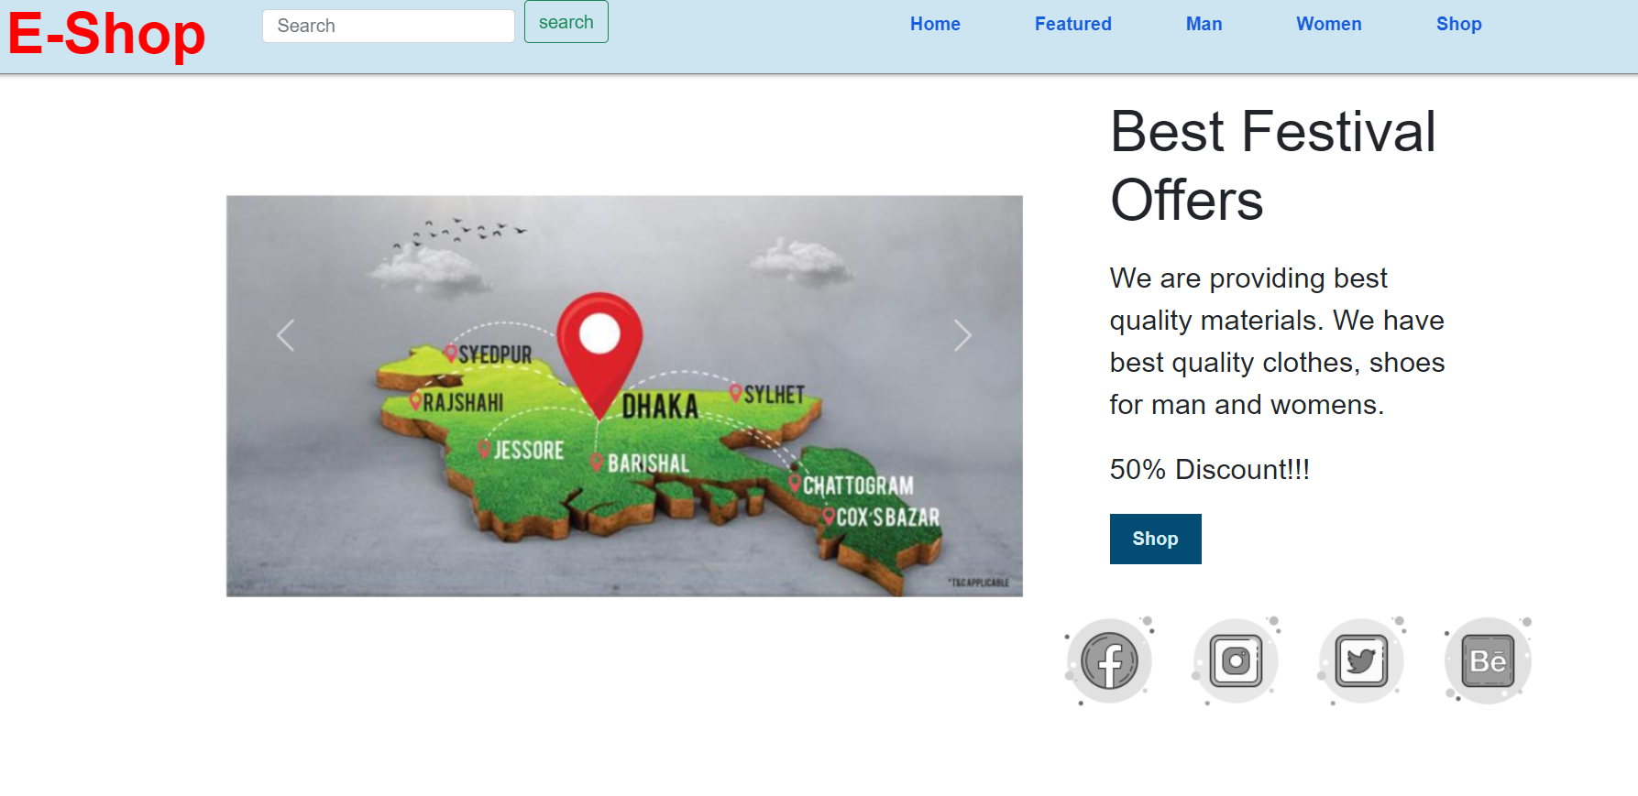
Home page

Slide 9
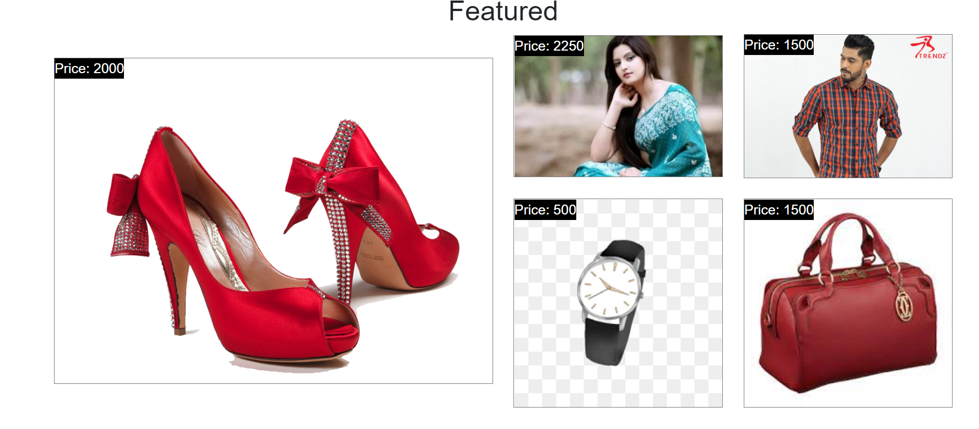
Featured page :-

Slide 10
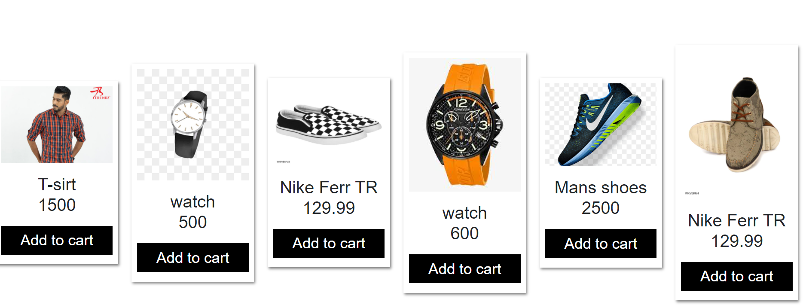
Products details

Slide 11
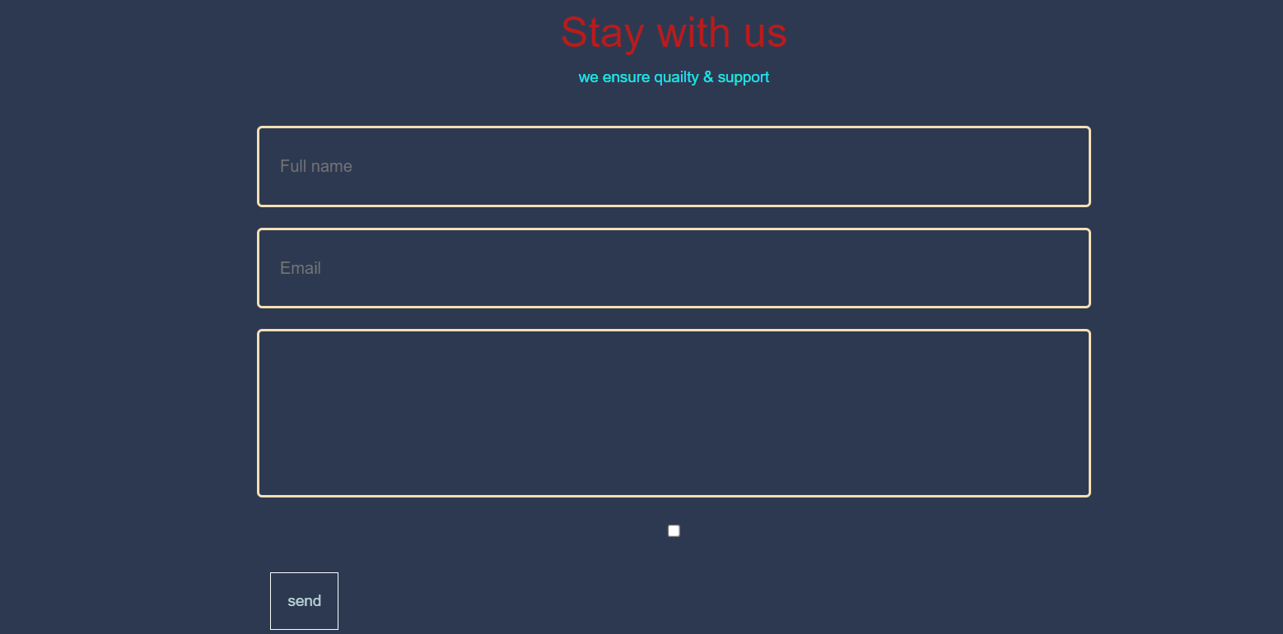

Contact page

Slide 12
Future task
Making the website fully dynamic using MySQL database and Create individual seller id in which they can add product and sell product like evaly and daraz.

Slide 13
Future features of the website
Fully Responsive Design (Front end and backend)
Using bootstrap
HTML,CSS,Jquery, Javascript
Fully Dynamic Website Using Laravel framework.
Dynamic category/subcategory
Dynamic product, banner etc.
Shopping cart
Coupon (Duration time)
Fully operational search option
Stock and out of stock showing
Multiple language support(Bangla and English)
Payment system
Multiple users role
Showing monthly total income(profit) or losses per individual category.

Slide 14
Problems May Face
Creating tables for the website
Setup online payment method
Adding discount and cuppon
Make a fully operational admin panel which shows monthly income/loss per individual category.

Slide 15
Conclusion
E-commerce still represents one of the business methods that take advantage if done the right way, even if the stock market and commodities fell, but E-Commerce still able to survive and receive high transaction. E-commerce has a tremendous opportunity in the course of or business in Malaysia. In addition, it is also to introducing new techniques and styles in a transaction. Use the extensive E-Commerce in the Internet world is actually much better to bring the goodness of the individual or the state.

Slide 16
Thank You All
Thank You All

Slide 17
Any Questions?

